Slide 1

Chapter 24 – Relational Databases

Slide 2

Chapter Goals
To understand how relational databases store information
To learn to query a database with the structured Query language (SQL) to connect to a database with Java Database Connectivity (JDBC)
To write database programs that insert, update, and query data in a relational database

Slide 3
Organizing Database Information
A relational database stores information in tables. Each table column has a name and data type.

Slide 4
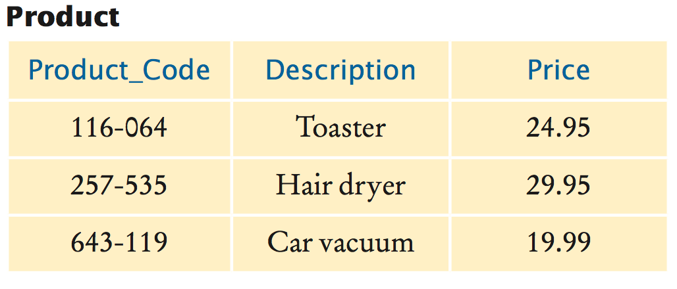
Product Table
Each row corresponds to a product.
Column headers correspond to attributes of the product. All items in the same column are the same data type.
Figure 1 A Product Table in a Relational Database

Slide 5
SQL
Structured Query Language (SQL):
Command language for interacting with databases.
Most relational databases follow the SQL standard. Not case sensitive:
"create table" = "CREATE TABLE"
We will use uppercase letters for SQL keywords and mixed case for table and column names.

Slide 6
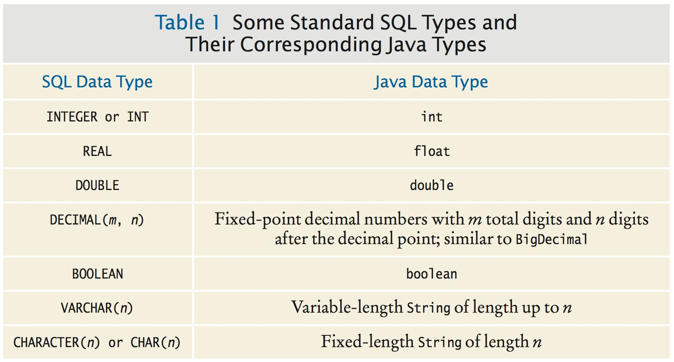
SQL Types

Slide 7
SQL Command to Create a Table
CREATE TABLE Product (
Product_Code CHAR(7), Description VARCHAR(40), Price DECIMAL(10, 2)
)

Slide 8
SQL Command to Insert a Row
Use the INSERT INTO command to insert a row into the table. Issue one command for each row, such as:
INSERT INTO Product
VALUES ('257-535', 'Hair dryer', 29.95)

Slide 9
More SQL
SQL uses single quotes ('), not double quotes, to delimit strings. What if you have a string that contains a single quote?
Write the single quote twice:
'Sam''s Small Appliances'
To remove an existing table use the DROP TABLE command:
DROP TABLE Test

Slide 10
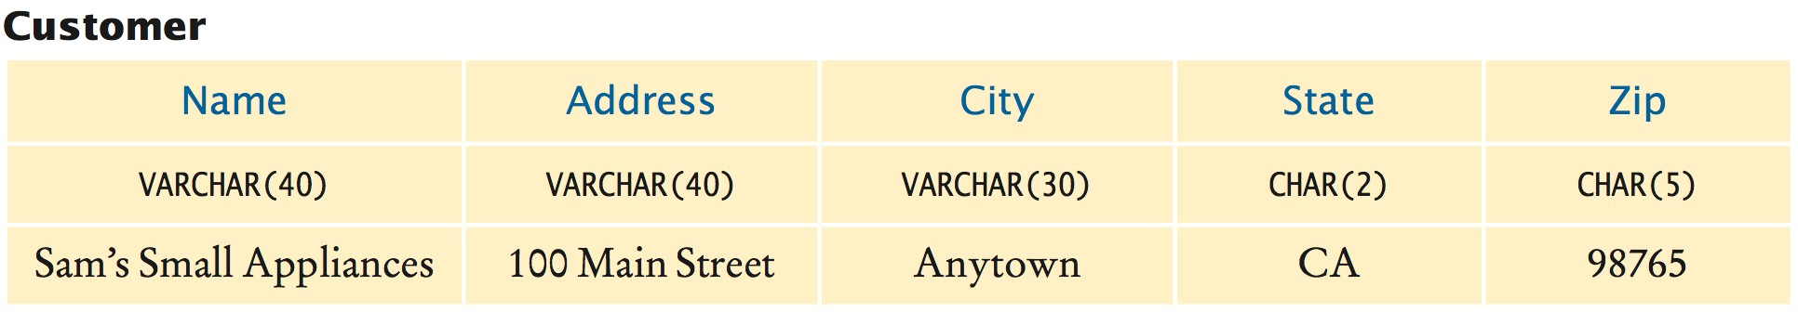
Customer Table
Java class Customer
public class Customer
{
private String name; private String address; private String city; private String state; private String zip;
...
}
Customer table:
Figure 2 A Customer Table

Slide 11
Invoice Table
For other objects, it is not so easy to come up with an equivalent database table structure.
Consider an invoice.
Each invoice object contains a reference to a customer object:
public class Invoice
{
private int invoiceNumber; private Customer theCustomer;
. . .
}

Slide 12
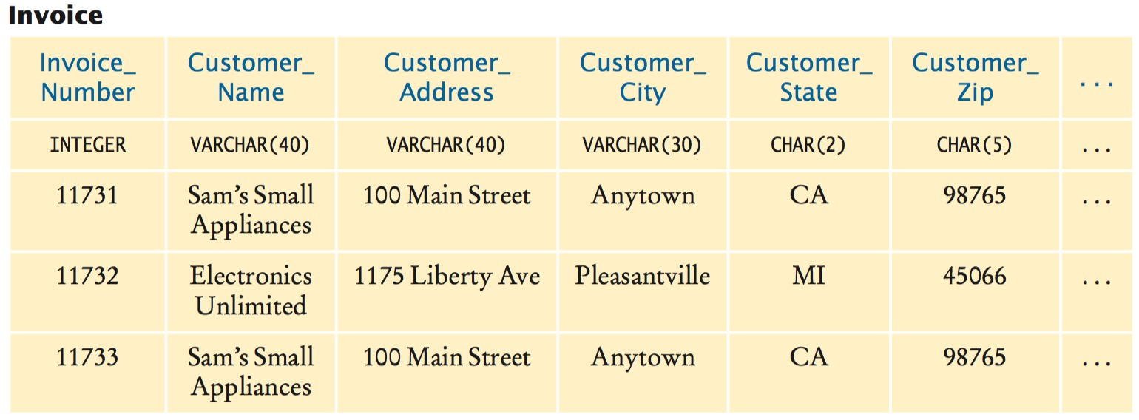
Invoice Table
You might consider simply entering all the customer data into the invoice tables.
It is wasteful.
It is dangerous: on a change, you can forget to update all occurrences.
In a Java program, neither of these problems occur.
Multiple Invoice objects can contain references to a single Customer.
Figure 3 A Poor Design for an Invoice Table with Replicated Customer Data

Slide 13
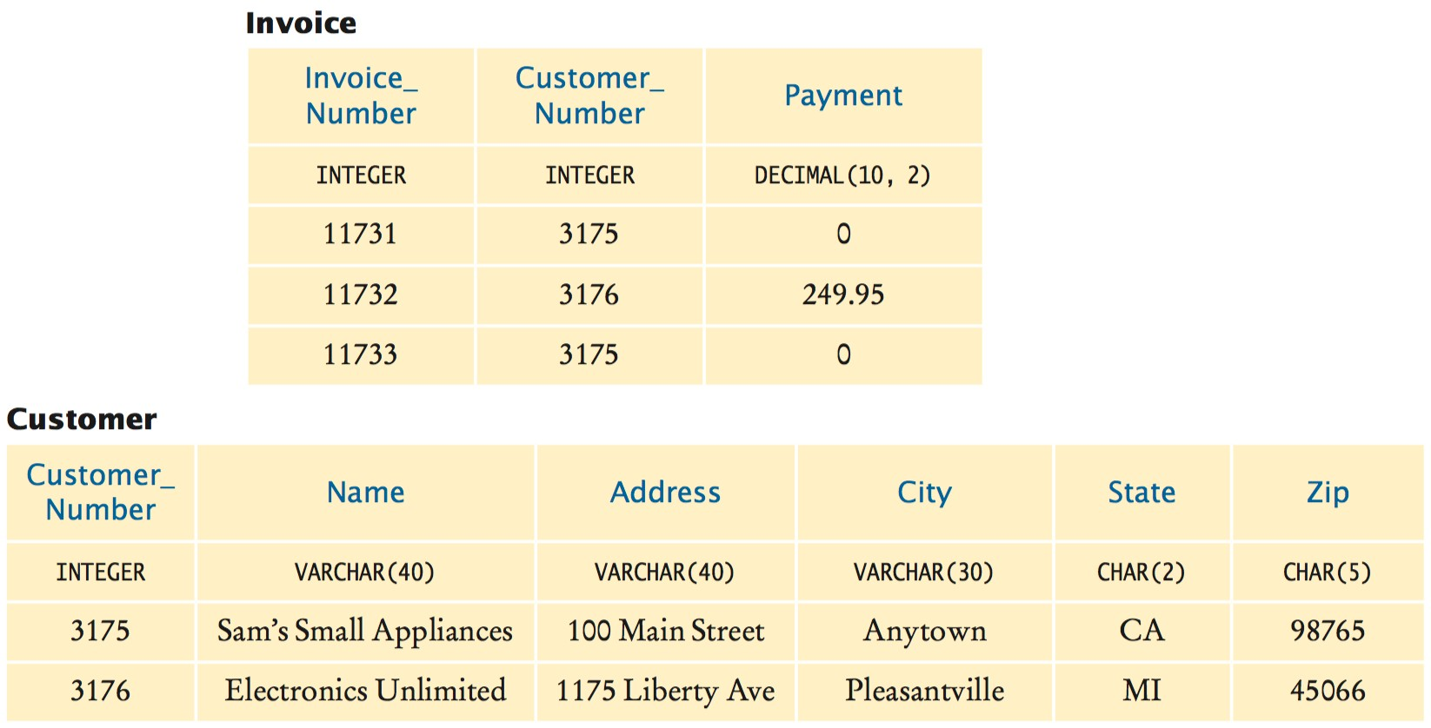
Linking Tables
Replicating the same data in multiple rows has two problems:
Wasteful to store the same information multiple times.
If the data needs to change, it has to be changed in multiple places.
Instead you should distribute the data over multiple tables.
Figure 4 Two Tables for Invoice and Customer Data

Slide 14
Linking Tables
In Figure 4, customer data are not replicated.
Customer table contains a single record for each customer. Invoice table has no customer data.
The two tables are linked by the Customer_Number field.
The customer number is a unique identifier.
We introduced the customer number because the customer name by itself may not be unique.

Slide 15
Primary and Foreign Keys
Primary key: a column (or combination of columns) whose value uniquely specifies a table record.
Not all database tables need a primary key.
You need a primary key if you want to establish a link from another table.
Foreign key: a reference to a primary key in a linked table. Foreign keys need not be unique.

Slide 16
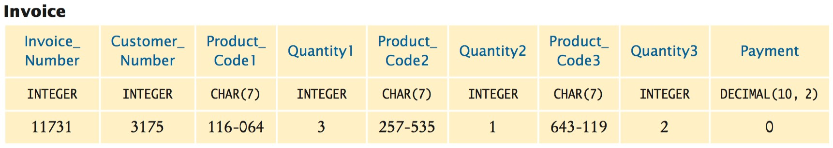
Implementing Multi-Valued Relationships
Each invoice may have many line items.
Do not replicate columns, one for each line item: Poor design:
Figure 5 A Poor Design for an Invoice Table with Replicated Columns

Slide 17
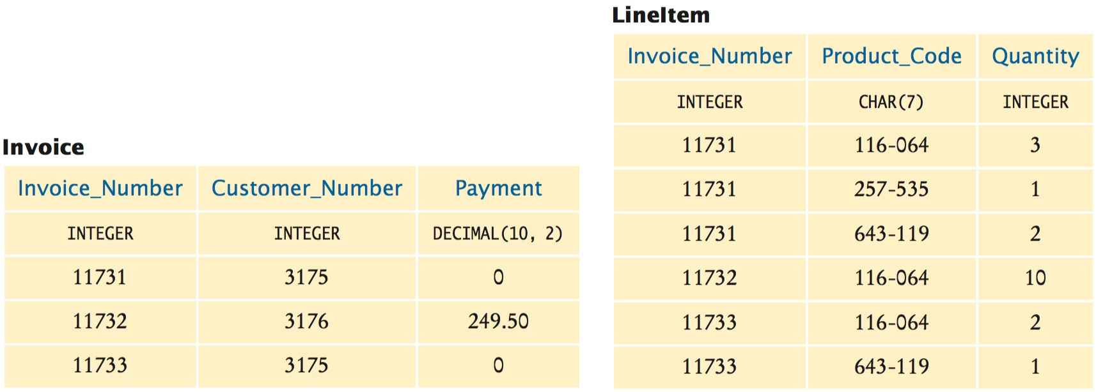
Implementing Multi-Valued Relationships
Instead, distribute the information in two tables.
One table for invoices and another table for line items.
Link each line item to its invoice with an Invoice_Number foreign key in the line item table:
Figure 6 Linked Invoice and LineItem Tables Implement a Multi-Valued Relationship

Slide 18
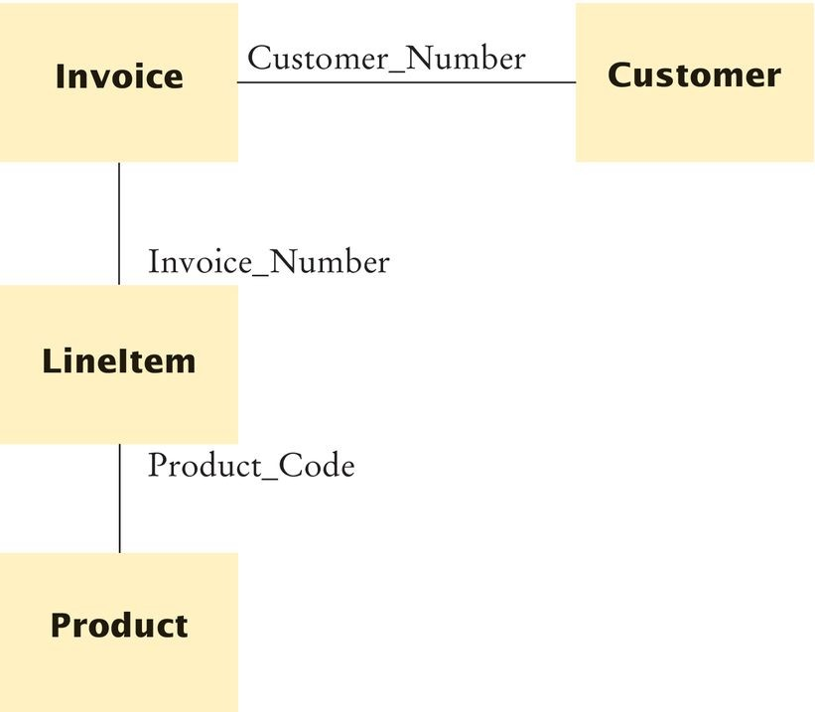
Sample Database
Database now consists of four tables:
Invoice Customer LineItem Product
Figure 7 The Links Between the Tables in the Sample Database

Slide 19
Self Check 24.1
Would a telephone number be a good primary key for a customer table?
Answer: The telephone number for each customer may not be unique— the same number might be shared by roommates. Even if the number were unique, however, it can change when a customer moves. In that situation, both the primary and all foreign keys would need to be updated. Therefore, a customer ID is a better choice.

Slide 20
Self Check 24.2
In the database of Section 24.1.3, what are all the products that customer 3176 ordered?
Answer: Customer 3176 ordered ten toasters.

Slide 21
Queries
Once the database is constructed, we can query it for information.
What are the names and addresses of all customers?
What are the names and addresses of all customers in California?
What are the names and addresses of all customers who bought toasters? What are the names and addresses of all customers with unpaid invoices?

Slide 22
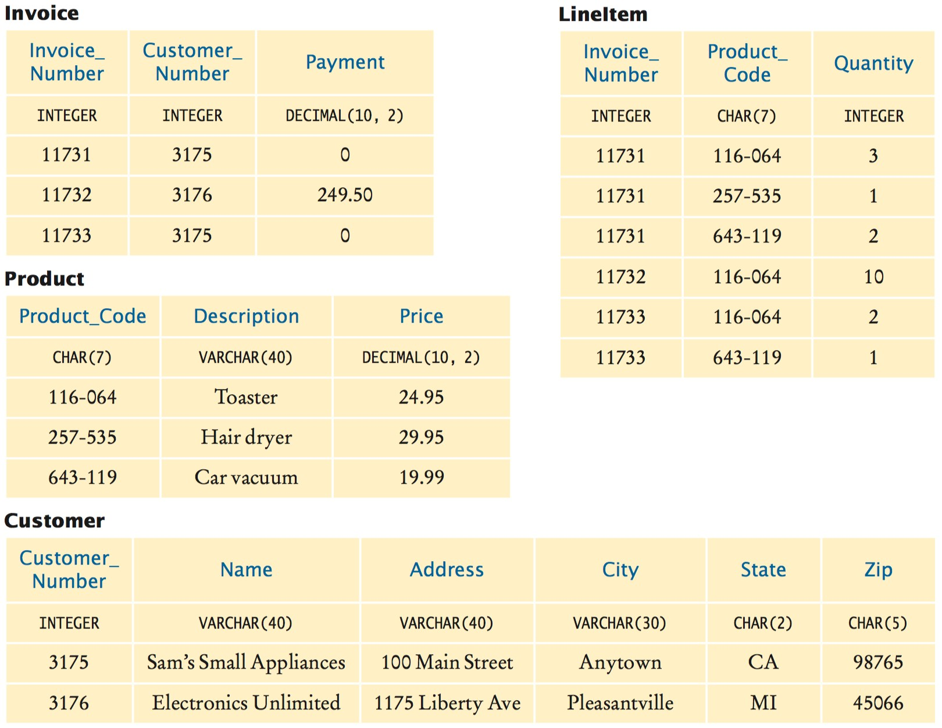
Sample Database
Figure 8 A Sample Database

Slide 23
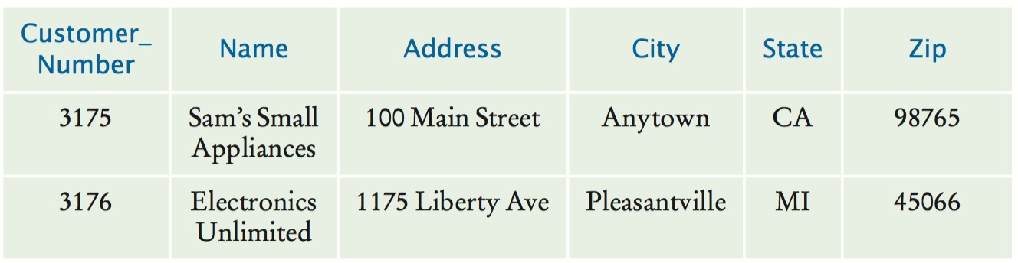
Simple Queries
Use the SQL SELECT statement to query a database. Query to select all data from the Customer table:
SELECT * FROM Customer
Result:
Outcome of a query is a view (a window through which you can see some of the database).

Slide 24
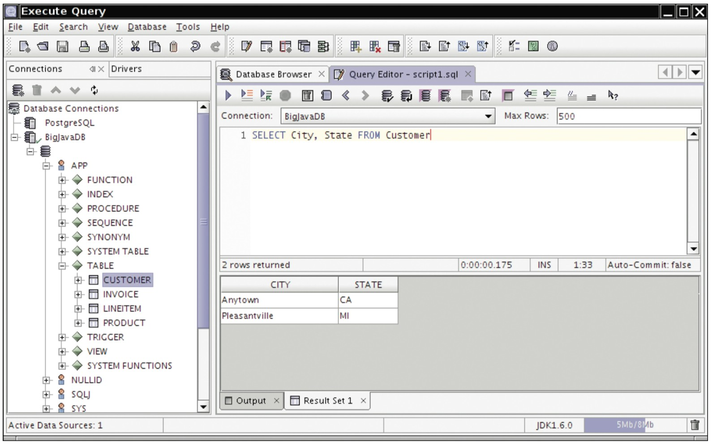
Interactive SQL Tool
Figure 9 An Interactive SQL Tool

Slide 25
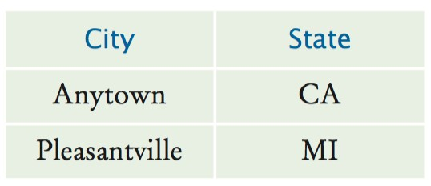
Selecting Columns
You may want to view only some of the columns in the table.
Query to select the city and state of all customers from the Customer table:
SELECT City, State FROM Customer
Result:

Slide 26
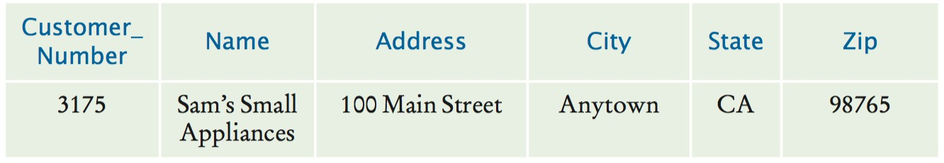
Selecting Subsets
You can select rows that fit a particular criteria. To select a subset, use the WHERE clause.
Query to find all customers in California:
SELECT * FROM Customer WHERE State = 'CA'
Result:

Slide 27
Selecting Subsets
Match patterns with LIKE.
Right-hand side is a string that can contain special characters. Special symbol _ matches exactly one character.
Special symbol % matches any character sequence.
Expression to match all Name strings whose second character is an 'o':
Name LIKE '_o%'

Slide 28
Selecting Subsets
Combine expressions with logical connectives AND, OR, or NOT:
SELECT * FROM Product WHERE Price < 100 AND Description <> 'Toaster'
You can select both row and column subsets:
SELECT Name, City FROM Customer WHERE State = 'CA'

Slide 29
Calculations
Use the COUNT function to find out how many customers there are in California:
SELECT COUNT(*) FROM Customer WHERE State = 'CA'
The * means you want to calculate whole records. Other functions: SUM, AVG, MAX, and MIN.
These functions must access a specific column:
SELECT AVG(Price) FROM Product

Slide 30
Joins
The information you want may be spread over multiple tables. TableName.ColumnName denotes the column in a particular table. E.g., to select all invoices that include a car vacuum:
SELECT LineItem.Invoice_Number FROM Product, LineItem
WHERE Product.Description = 'Car vacuum'
AND Product.Product_Code = LineItem.Product_Code

Slide 31
Joins
Join: a query that involves multiple tables. When using a join, do these things:
List all tables that are involved in the query in the FROM clause.
Use the TableName.ColumnName syntax to refer to column names. List all join conditions in the WHERE clause:
(TableName1.ColumnName1 = TableName2.ColumnName2)

Slide 32
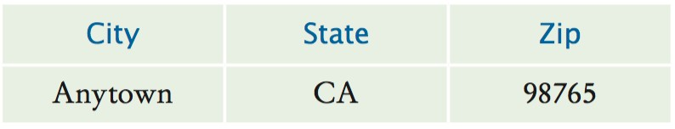
Joins
E.g., in what cities are hair dryers sold?
Need to query the Customer table because it contains the customer addresses.
Products are selected by description 'Hair dryer'. Line items are linked to products by Product_Code Invoices are linked to line items by Invoice_Number.
Finally, customers are linked to invoices by Customer_Number.
SELECT Customer.City, Customer.State, Customer.Zip FROM Product, LineItem, Invoice, Customer
WHERE Product.Description = 'Hair dryer'
AND Product.Product_Code = LineItem.Product_Code AND LineItem.Invoice_Number =
Invoice.Invoice_Number
AND Invoice.Customer_Number = Customer.Customer_Number
Result:

Slide 33
Updating and Deleting Data
DELETE and UPDATE commands modify the contents of the database.
DELETE command deletes rows.
E.g., to delete all customers in California:
DELETE FROM Customer WHERE State = 'CA'

Slide 34
Updating and Deleting Data
UPDATE query lets you update columns of all records that fulfill a certain condition.
E.g., to add one to the quantity of every line item for invoice number
11731:
UPDATE LineItem
SET Quantity = Quantity + 1 WHERE Invoice_Number = '11731'
Update multiple column values by specifying multiple update expressions in the SET clause, separated by commas.
Both UPDATE and DELETE return the number of rows updated or deleted.

Slide 35
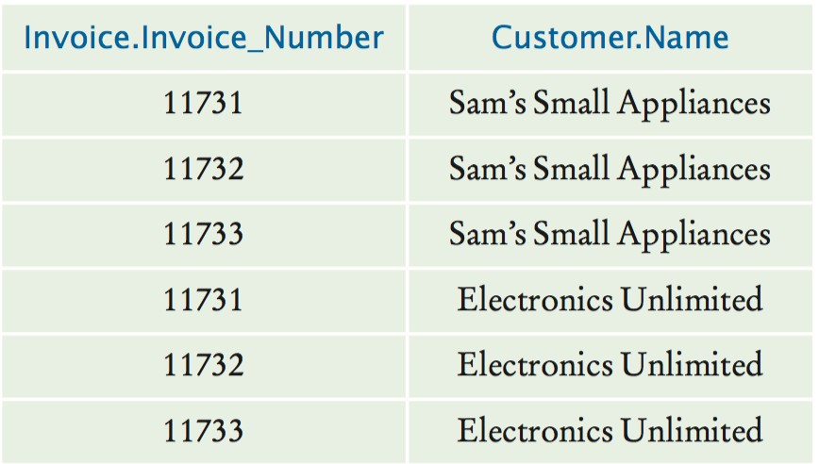
Common Error: Joining Tables Without Specifying a Link Condition
If you select data from multiple tables without a restriction, you get a result set containing all combinations of the values:
SELECT Invoice.Invoice_Number, Customer.Name FROM Invoice, Customer
Result:

Slide 36
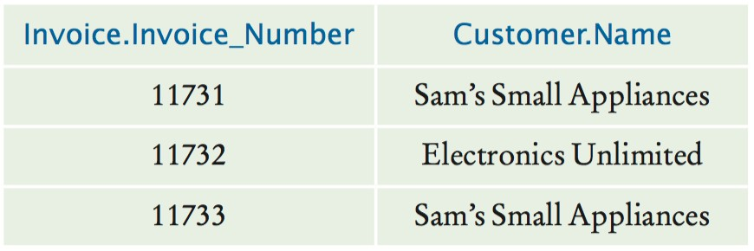
Common Error: Joining Tables Without Specifying a Link Condition
You need to supply a WHERE clause to restrict the set of combinations:
SELECT Invoice.Invoice_Number, Customer.Name FROM Invoice, Customer
WHERE Invoice.Customer_Number =
Customer.Customer_Number
Result:

Slide 37
Self Check 24.3
How do you query the names of all customers that are not from Alaska or Hawaii?
Answer:
SELECT Name
FROM Customer
WHERE State <> 'AK' AND State <> 'HI'

Slide 38
Self Check 24.4
How do you query all invoice numbers of all customers in Hawaii?
Answer:
SELECT Invoice.Invoice_Number FROM Invoice, Customer
WHERE Invoice.Customer_Number
= Customer.Customer_Number AND Customer.State = 'HI'

Slide 39
Installing a Database
Wide variety of database systems available, including:
Production-quality databases, such as Oracle, IBM DB2, Microsoft SQL Server, PostgreSQL, or MySQL.
Lightweight Java databases, such as Apache Derby. Desktop databases, such as Microsoft Access.

Slide 40
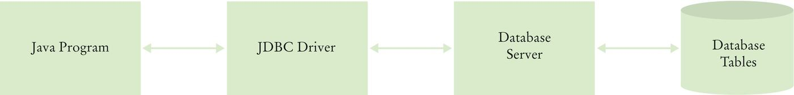
JDBC
JDBC: Java Database Connectivity.
You need a JDBC driver to access a database from a Java program. Different databases require different drivers.
Drivers may be supplied by the database manufacturer or a third party.
When your Java program issues SQL commands, the driver forwards them to the database and lets your program analyze the results.
Figure 10 An Interactive SQL Tool

Slide 41
Apache Derby
Included in JDK.
Can also download from http://db.apache.org/derby/.
Test with program TestDB:
Locate the JDBC driver file derby.jar and copy it into the ch23/section_3 directory of the companion code for this book.
Open a command shell, change to the
ch23/section_3 directory, and run:
javac TestDB.java
java -classpath derby.jar;. TestDB database.properties
On Linux, UNIX or Mac OS X, use a colon instead of a semicolon as a path separator:
javac TestDB.java
java -classpath derby.jar:. TestDB database.properties
If you see one line of output with the name 'Romeo', then Apache Derby is properly installed.

Slide 42
Installing a Database
Detailed instructions for installing a database vary widely.
General sequence of steps on how to install a database and test your installation:
Install the database program. Start the database.
Set up user accounts.
Run a test using the database's interactive SQL program:
CREATE TABLE Test (Name CHAR(20)) INSERT INTO Test VALUES ('Romeo') SELECT * FROM Test
DROP TABLE Test
Note that you may need a special terminator for each SQL statement (e.g., ';').

Slide 43
Testing a JDBC Driver
Find the class path for the driver, e.g.:
c:\jdk1.7.0\db\lib\derby.jar
Or, for a sample Oracle installation:
/usr/local/oracle/jdbc/classes111b.zip
If your JDBC driver is not fully compliant with the JDBC4 standard, you need to know the name of the driver class, e.g.:
oracle.jdbc.driver.OracleDriver
Consult your database's JDBC driver documentation.
Find the name of the database URL that your driver expects.
jdbc:subprotocol:driver-specific data
Examples:
jdbc:derby:InvoiceDB;create=true jdbc:oracle:thin:@larry.mathcs.sjsu.edu:1521:InvoiceDB

Slide 44
Testing a JDBC Driver
Edit the file database.properties and set:
The driver class name (if required). The database URL.
Your database user name. Your database password.
Compile the program as:
javac TestDB.java
Run the program as:
java -classpath driver_class_path;. TestDB database.properties
Or, on UNIX/Linux/Mac OS X:
java -classpath driver_class_path:. TestDB database.properties

Slide 45
Testing a JDBC Driver
Possible problems:
Missing driver Check the class path and the driver name.
Driver cannot connect to the database The database may not be started or the database server may not be reachable.
Failed login Check the database name, user name, and password.
Missing test table Make sure you create and populate the table as previously described in the database test.

Slide 46
section_3/TestDB.java
import java.io.File;
import java.sql.Connection;
import java.sql.ResultSet;
import java.sql.Statement;
5
6
7
8
9
10
11
12
13
14
15
16
17
18
19
20
21
22
23
24
25
26
27
28
29
30
31
32
33
34
35
/**
Tests a database installation by creating and querying a sample table. Call this program as
java -classpath driver_class_path;. TestDB propertiesFile
*/
public class TestDB
{
public static void main(String[] args) throws Exception
{
if (args.length == 0)
{
System.out.println(
"Usage: java -classpath driver_class_path"
+ File.pathSeparator
+ ". TestDB propertiesFile"); return;
}
SimpleDataSource.init(args[0]);
try (Connection conn = SimpleDataSource.getConnection())
{
Statement stat = conn.createStatement();
stat.execute("CREATE TABLE Test (Name VARCHAR(20))"); stat.execute("INSERT INTO Test VALUES ('Romeo')");
ResultSet result = stat.executeQuery("SELECT * FROM Test"); result.next(); System.out.println(result.getString("Name"));

Slide 47
section_3/SimpleDataSource.java
import java.sql.Connection;
import java.sql.DriverManager;
import java.sql.SQLException;
import java.io.FileInputStream;
import java.io.IOException;
import java.util.Properties;
7
8
9
10
11
12
13
14
15
16
17
18
19
20
21
22
23
24
25
26
27
28
29
30
31
32
33
34
35
/**
A simple data source for getting database connections.
*/
public class SimpleDataSource
{
private static String url; private static String username; private static String password;
/**
Initializes the data source.
@param fileName the name of the property file that contains the database driver, URL, username, and password
*/
public static void init(String fileName)
throws IOException, ClassNotFoundException
{
Properties props = new Properties(); FileInputStream in = new FileInputStream(fileName); props.load(in);
String driver = props.getProperty("jdbc.driver"); url = props.getProperty("jdbc.url");
username = props.getProperty("jdbc.username"); if (username == null) { username = ""; } password = props.getProperty("jdbc.password"); if (password == null) { password = ""; }
if (driver != null) { Class.forName(driver); }

Slide 48
section_3/database.properties (for Apache Derby)
jdbc.url=jdbc:derby:BigJavaDB;create=true
# With other databases, you may need to add entries such as these
# jdbc.username=admin
# jdbc.password=secret
# jdbc.driver=org.apache.derby.jdbc.EmbeddedDriver

Slide 49
Self Check 24.5
After installing a database system, how can you test that it is properly installed?
Answer: Connect to the database with a program that lets you execute SQL instructions. Try creating a small database table, adding a record, and selecting all records. Then drop the table again.

Slide 50
Self Check 24.6
You are starting a Java database program to use the Apache Derby database and get the following error message:
Exception in thread "main" java.sql.SQLException: No suitable driver found for jdbc:derby:BigJavaDB;create=true
What is the most likely cause of this error?
Answer: You didn’t set the class path correctly. The JAR file containing the JDBC driver must be on the class path.

Slide 51
Database Programming in Java
Use a Connection object to access a database from a Java program. First, the database driver must be loaded.
Automatic with Java 6 + fully JDBC4 compatible driver. Otherwise, use this code:
String driver = ...; Class.forName(driver); // Load driver
Next, ask the DriverManager for a connection:
String url = ...; String username = ...; String password = ...;
Connection conn = DriverManager.getConnection(url, username, password);
When finished with database commands, close the database. Use the try-with-resources statement:
try (Connection conn = . . .)
{
Work with conn.
}

Slide 52
Connecting to the Database
Decouple connection management from the other database code. We supply a SimpleDataSource class to do this.
Call its static init method with the name of the database configuration file:
SimpleDataSource.init("database.properties");
Configuration file is a text file that may contain these lines:
jdbc.driver=... jdbc.url=... jdbc.username=... jdbc.password=...

Slide 53
Connecting to the Database
init method uses the Properties class to read the file.
Properties class has a load method to read a file of key/value pairs from a stream:
Properties props = new Properties(); FileInputStream in = new FileInputStream(fileName); props.load(in);
The getProperty method returns the value of a given key:
String driver = props.getProperty("jdbc.driver");
Now when you need a connection call:
try (Connection conn = SimpleDataSource.getConnection())
{
Work with conn.
}

Slide 54
Executing SQL Statements
Connection object creates Statement objects:
Statement stat = conn.createStatement();
execute method of the Statement class executes a SQL statement:
stat.execute("CREATE TABLE Test (Name VARCHAR(20))"); stat.execute("INSERT INTO Test VALUES ('Romeo')");
Use executeQuery method of the Statement class to issue a query:
String query = "SELECT * FROM Test"; ResultSet result = stat.executeQuery(query);
Result of a SQL query is returned in a ResultSet object.

Slide 55
Executing SQL Statements
Use executeUpdate method of Statement class to execute an UPDATE
statement.
Method returns the number of rows effected:
String command = "UPDATE LineItem"
+ " SET Quantity = Quantity + 1"
+ " WHERE Invoice_Number = '11731'"; int count = stat.executeUpdate(command);

Slide 56
Executing SQL Statements
If your statement has variable parts, use a PreparedStatement:
String query = "SELECT * WHERE Account_Number = ?"; PreparedStatement stat = conn.prepareStatement(query);
The ? symbols denote variables that you fill in when you make an actual query.
Call a set method to fill this variables:
stat.setString(1, accountNumber);
The first parameter to the set methods denotes the variable position (1 is the first ?).
There are also methods setInt and setDouble.
After setting all variables, call executeQuery or executeUpdate.

Slide 57
Executing SQL Statements
Can also use a generic execute method to execute queries.
It returns a boolean value to indicate whether SQL command yields a result set.
If there is a result set, get it with the getResultSet method. Otherwise, get the update count with the getUpdateCount method:
String command = ... ;
boolean hasResultSet = stat.execute(command); if (hasResultSet)
{
ResultSet result = stat.getResultSet();
...
}
else
{
int count = stat.getUpdateCount();
...
}

Slide 58
Executing SQL Statements
Can reuse a Statement or PreparedStatement object.
For each statement, you should only have one active ResultSet.
If you need to look at multiple result sets at the same time, create multiple
Statement objects.
Close the current ResultSet before issuing a new query on the same statement:
result.close();
When you are done with a Statement object be sure it is closed by using a try-with-resources statement:
try (PreparedStatement stat = conn.prepareStatement(query))
{
Configure stat.
ResultSet result = stat.getResultSet();
Analyze result.
}
Also closes the ResultSet from the Statement.

Slide 59
Analyzing Query Results
Use the next method of the ResultSet to iterate through the query results a row at a time.
When a result set is first returned from an executeQuery, no row data are available.
Use the next method to move to the first row.
The next method returns a boolean value indicating whether more rows of data are available:
while (result.next())
{
Inspect column data from the current row
}

Slide 60
Analyzing Query Results
To get the column values from a row, use one of the various get methods. Two get methods for each type of data (string, integer, double).
One get method uses an integer parameter that indicates the column position.
Column positions start at 1:
String productCode = result.getString(1);

Slide 61
Analyzing Query Results
Other type of get method uses a string parameter for the column name:
String productCode = result.getString("Product_Code");
Use getInt to fetch an integer column value:
int quantity = result.getInt("Quantity");
Use getDouble to fetch an double column:
double unitPrice = result.getDouble("Price");
Better to use column names than numbers to access columns. Code is easier to read, and column order may change.

Slide 62
Result Set Meta Data
Result set meta data describes the properties of the result set.
Use the ResultSetMetaData class to find out the column names in an unknown table.
Get the meta data object from the result set:
ResultSetMetaData metaData = result.getMetaData();

Slide 63
Result Set Meta Data
Use getColumnCount method to get the number of columns. Use getColumnLabel method to get the name of each column. Use getColumnDisplaySize method to get the column width:
for (int i = 1; i <= metaData.getColumnCount(); i++)
{
String columnName = metaData.getColumnLabel(i); int columnSize = metaData.getColumnDisplaySize(i);
...
}

Slide 64
Result Set Meta Data
The following program reads a file containing SQL statements and executes them.
If there is a result set, the result set is printed.
Meta data from the result set is used to determine the column count and column label.
Run the program as:
java -classpath derby.jar;. ExecSQL database.properties Product.sql
Or interactively as:
java -classpath derby.jar;. ExecSQL database.properties

Slide 65
Product.sql
CREATE TABLE Product
(Product_Code CHAR(7), Description VARCHAR(40), Price DECIMAL(10, 2)) INSERT INTO Product VALUES ('116-064', 'Toaster', 24.95)
INSERT INTO Product VALUES ('257-535', 'Hair dryer', 29.95) INSERT INTO Product VALUES ('643-119', 'Car vacuum', 19.95)
SELECT * FROM Product

Slide 66
section_4/ExecSQL.java
import java.sql.Connection;
import java.sql.ResultSet;
import java.sql.ResultSetMetaData;
import java.sql.Statement;
import java.sql.SQLException;
import java.io.File;
import java.io.IOException;
import java.util.Scanner;
9
10
11
12
13
14
15
16
17
18
19
20
21
22
23
24
25
26
27
28
29
30
31
32
33
34
35
36
/**
Executes all SQL statements from a file or the console.
*/
public class ExecSQL
{
public static void main(String[] args)
throws SQLException, IOException, ClassNotFoundException
{
if (args.length == 0)
{
System.out.println(
"Usage: java -classpath driver_class_path"
+ File.pathSeparator
+ ". ExecSQL propertiesFile [SQLcommandFile]"); return;
}
SimpleDataSource.init(args[0]);
Scanner in;
if (args.length > 1)
{
in = new Scanner(new File(args[1]));
}
else
{
in = new Scanner(System.in);

Slide 67
Common Error: Constructing Queries from Arbitrary Strings
Suppose you issue query using different names:
SELECT * FROM Customer WHERE Name = customerName
Students commonly build the SELECT statment like:
String customerName = . . . ;
String query = "SELECT * FROM Customer WHERE Name = '" + customerName + "'"; ResultSet result = stat.executeQuery(query);
Fails if the customerName is a string like "Sam's Small
Hackers can deliberately attack code like this.
Use PreparedStatement instead to prevent problems:
Appliances".
String query = "SELECT * FROM Customer WHERE Name = ?"; PreparedStatement stat = conn.prepareStatement(query); stat.setString(1, aName);
ResultSet result = stat.executeQuery(query);

Slide 68
Self Check 24.7
Suppose you want to test whether there are any customers in Hawaii. Issue the statement
ResultSet result = stat.executeQuery("SELECT * FROM Customer WHERE State = 'HI'");
Which Boolean expression answers your question?
Answer: result.next(). If there is at least one result, then next
returns true.

Slide 69
Self Check 24.8
Suppose you want to know how many customers are in Hawaii. What is an efficient way to get this answer?
Answer:
ResultSet result = stat.executeQuery( "SELECT COUNT(*) FROM Customer "
+ "WHERE State = 'HI'");
result.next();
int count = result.getInt(1);
Note that the following alternative is significantly slower if there are many such customers.
ResultSet result = stat.executeQuery( "SELECT * FROM Customer "
+ "WHERE State = 'HI'");
while (result.next()) { count++; } // Inefficient

Slide 70
Application: Entering an Invoice
Task: Develop a program for entering an invoice into the sample database:
Name: Robert Lee
Street address: Lyon Street City: San Francisco
State: CA Zip: 94155
Product code (D=Done, L=List): L 116-064 Toaster
257-535 Hair dryer
643-119 Car vacuum
Product code (D=Done, L=List): 116-064 Quantity: 2
Product code (D=Done, L=List): 257-535 Quantity: 3
Product code (D=Done, L=List): D Robert Lee
833 Lyon Street
San Francisco, CA 94155
x 116-064 Toaster
x 257-535 Hair dryer

Slide 71
Create Tables
Assume that the Customer, Product, Invoice, and LineItem tables have been created.
You can simply run the ExecSQL program of previous section with the following files:
Customer.sql Product.sql Invoice.sql LineItem.sql

Slide 72
Get Connection
Use SimpleDataSource helper class to get a database connection. Then call newCustomer so it can prompt for the customer information:
SimpleDataSource.init(args[0]);
try (Connection conn = SimpleDataSource.getConnection(), Scanner in = new Scanner(System.in))
{
addInvoice(in, conn);
}

Slide 73
newCustomer Method
private static int newCustomer(Connection conn, Scanner in) throws SQLException
{
String name = nextLine(in, "Name");
String address = nextLine(in, "Street address"); String city = nextLine(in, "City");
String state = nextLine(in, "State"); String zip = nextLine(in, "Zip");
int id = . . .;
try (PreparedStatement stat = conn.prepareStatement( "INSERT INTO Customer VALUES (?, ?, ?, ?, ?, ?)"))
{
stat.setInt(1, id); stat.setString(2, name); stat.setString(3, address); stat.setString(4, city); stat.setString(5, state); stat.setString(6, zip); stat.executeUpdate();
}
return id;
}

Slide 74
Query For ID
try (Statement stat = conn.createStatement())
{
ResultSet result = stat.executeQuery(
"SELECT max(Customer_Number) FROM Customer"); result.next();
int id = result.getInt(1) + 1;
}
Potential problem: if two users access the database simultaneously, it is possible that both of them create a customer with the same ID at the same time.
Remedy: place the code for adding a customer inside a transaction. Skip this for simplicity (see Special Topic 24.2).
Also need to generate new invoice IDs.
Provide a method getID that works for both tables.

Slide 75
Add a Row to Invoice Table
Set the next invoice number:
int id = getNewId(conn, "Invoice");
try (PreparedStatement stat = conn.prepareStatement( "INSERT INTO Invoice VALUES (?, ?, 0)"))
{
stat.setInt(1, id); stat.setInt(2, customerNumber); stat.executeUpdate();
}

Slide 76
Check Product Code
When user provides a product code, check that it is valid:
try (PreparedStatement stat = conn.prepareStatement( "SELECT * FROM Product WHERE Product_Code = ?"))
{
stat.setString(1, code);
ResultSet result = stat.executeQuery(); boolean found = result.next();
}

Slide 77
List Product Codes
Query the products and list the results:
try (Statement stat = conn.createStatement())
{
ResultSet result = stat.executeQuery(
"SELECT Product_Code, Description FROM Product"); while (result.next())
{
String code = result.getString(1);
String description = result.getString(2); System.out.println(code + " " + description);
}
}

Slide 78
Product Codes and Quantities
Loop to add products to invoice:
boolean done = false; while (!done)
{
String productCode = nextLine(in, "Product code (D=Done, L=List)");
if (productCode.equals("D")) { done = true; }
else if (productCode.equals("L")) { listProducts(conn); } else if (findProduct(conn, productCode))
{
int quantity = nextInt(in, "Quantity"); addLineItem(conn, id, productCode, quantity);
}
else { System.out.println("Invalid product code."); }
}
showInvoice(conn, id);

Slide 79
showInvoice Method
Print the invoice.
Invoice ID is a parameter.
Find matching customer data by joining Invoice and Customer tables:
try (PreparedStatement stat = conn.prepareStatement( "SELECT Customer.Name, Customer.Address, "
+ "Customer.City, Customer.State, Customer.Zip "
+ "FROM Customer, Invoice "
+ "WHERE Customer.Customer_Number = "
+ "Invoice.Customer_Number "
+ "AND Invoice.Invoice_Number = ?"))
{
stat.setInt(1, id);
. . .
}
Query result contains customer information which is printed.

Slide 80
showInvoice Method
Get all line items and product descriptions, again linking two tables in a query:
try (PreparedStatement stat = conn.prepareStatement( "SELECT Product.Product_Code, Product.Description, "
+ "LineItem.Quantity "
+ "FROM Product, LineItem "
+ "WHERE Product.Product_Code = LineItem.Product_Code "
+ "AND LineItem.Invoice_Number = ?"))
{
stat.setInt(1, id);
. . .
}

Slide 81
section_5/InvoiceEntry.java
import java.sql.Connection;
import java.sql.PreparedStatement;
import java.sql.ResultSet;
import java.sql.SQLException;
import java.sql.Statement;
import java.io.IOException;
import java.io.File;
import java.util.Scanner;
9
10
11
12
13
14
15
16
17
18
19
20
21
22
23
24
25
26
27
28
29
30
31
32
33
34
35
/**
Enters an invoice into the database.
Be sure to add Customer.sql, Product.sql, Invoice.sql, and LineItem.sql to the database before running this program.
*/
public class InvoiceEntry
{
public static void main(String args[])
{
if (args.length == 0)
{
System.out.println(
"Usage: java -classpath driver_class_path"
+ File.pathSeparator
+ ". InvoiceEntry propertiesFile"); return;
}
try
{
SimpleDataSource.init(args[0]);
try (Connection conn = SimpleDataSource.getConnection(); Scanner in = new Scanner(System.in))
{
addInvoice(in, conn);
}

Slide 82
Self Check 24.9
Why do the InvoiceEntry methods throw a SQLException instead of catching it?
Answer: In this program, error reporting is the responsibility of the main
method.

Slide 83
Self Check 24.10
How could one simplify the first query of the showInvoice method?
Answer: By passing the customer number as an argument. Then the query would only involve the customer table.

Slide 84
Self Check 24.11
This program assumes that the customer does not pay at the time of order entry. How can the program be modified to handle payment?
Answer: The most convenient approach is to ask the user about the payment before entering the items. Then the payment can be added to the statement in the addInvoice method.

Slide 85
Self Check 24.12
This program does not display the amount due. How could we display it?
Answer: We can either compute it in the loop that displays the line items, or we can issue a query.
SELECT SUM(Product.Price * LineItem.Quantity) FROM Product, LineItem
WHERE Product.Product_Code
= LineItem.Product_Code
AND LineItem.Invoice_Number = ?

